Slide 1
Image Classification
Rebecca Wam & Megan Michael

Slide 2
Table of contents
01
03
05
02
04
06
Problem Statement
Challenge
Conclusion
Methods
Results
Fun fact

Slide 3
01
Problem Statement

Slide 4
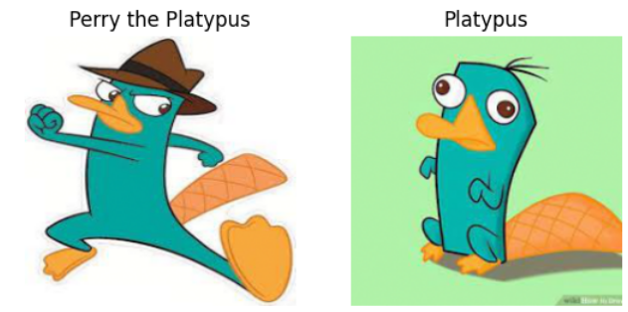
Image Classification using Perry the Platypus dataset
Identify if the image is a picture of perry when he is a normal platypus or when he becomes an agent
Visualise the neural network activity

Slide 5
02
Methods

Slide 6
Image Classification Models
Simple CNN
Transfer Learning Model
Initially started out with this model to see how it will perform
Heatmap to identify which area of the image is used to distinguish the class
Further enhanced our model by trying this out
VGG16
Notes:
Pretrained Model with Additional CNN Layers

Slide 7
03
Challenges

Slide 8
Challenges
Small dataset
Accuracy of simple CNN
Heatmap for VGG16
Implemented data augmentation to provide more input into the model
The accuracy of the simple CNN model is not very good compared to the transfer learning model probably as there are more layers in the vgg16 model and it was pre-trained on a larger dataset
Since the heatmap uses the last convolution layer of the model to plot the colours, we had to add more convolution layers on top of the vgg16 model to track the progress for the heatmap

Slide 9
04
Results

Slide 10
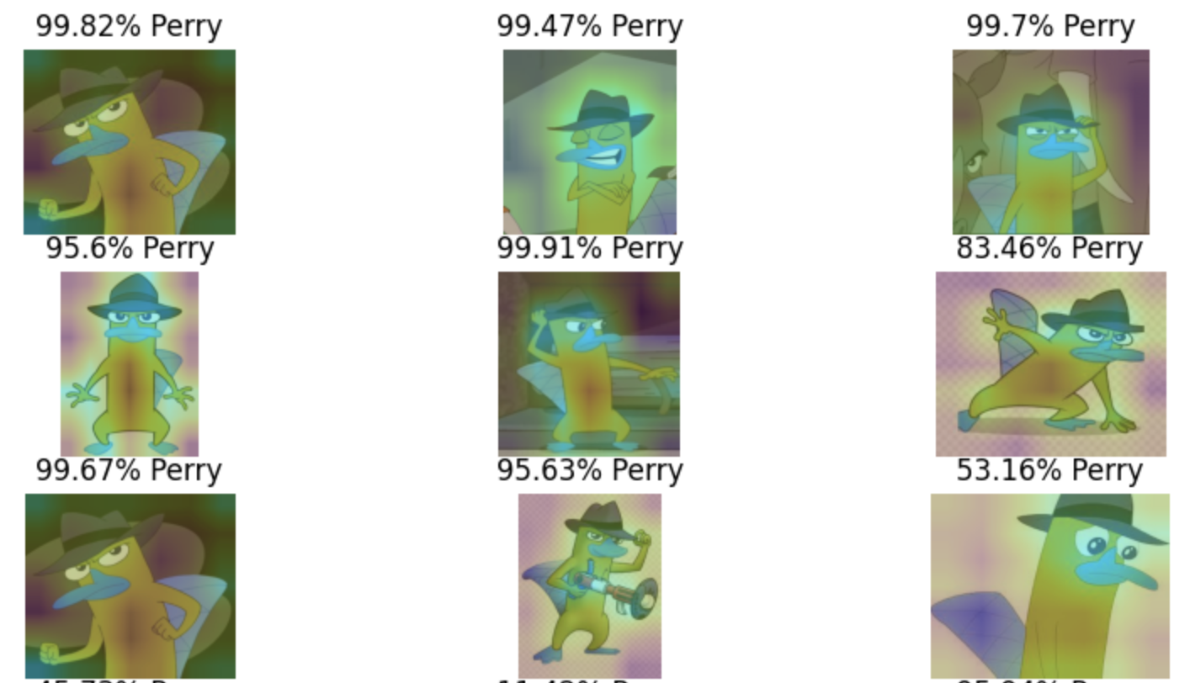
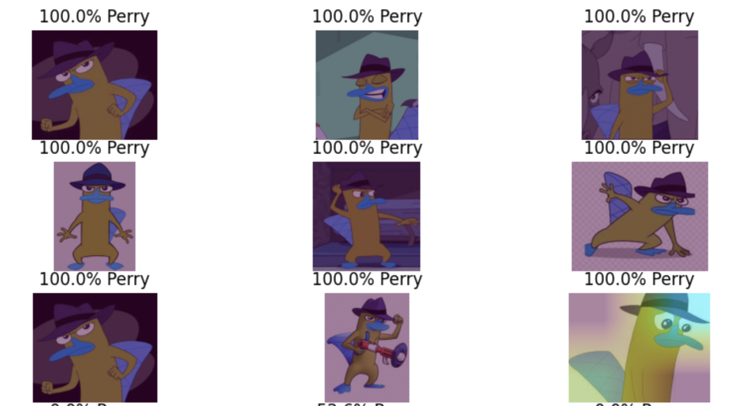
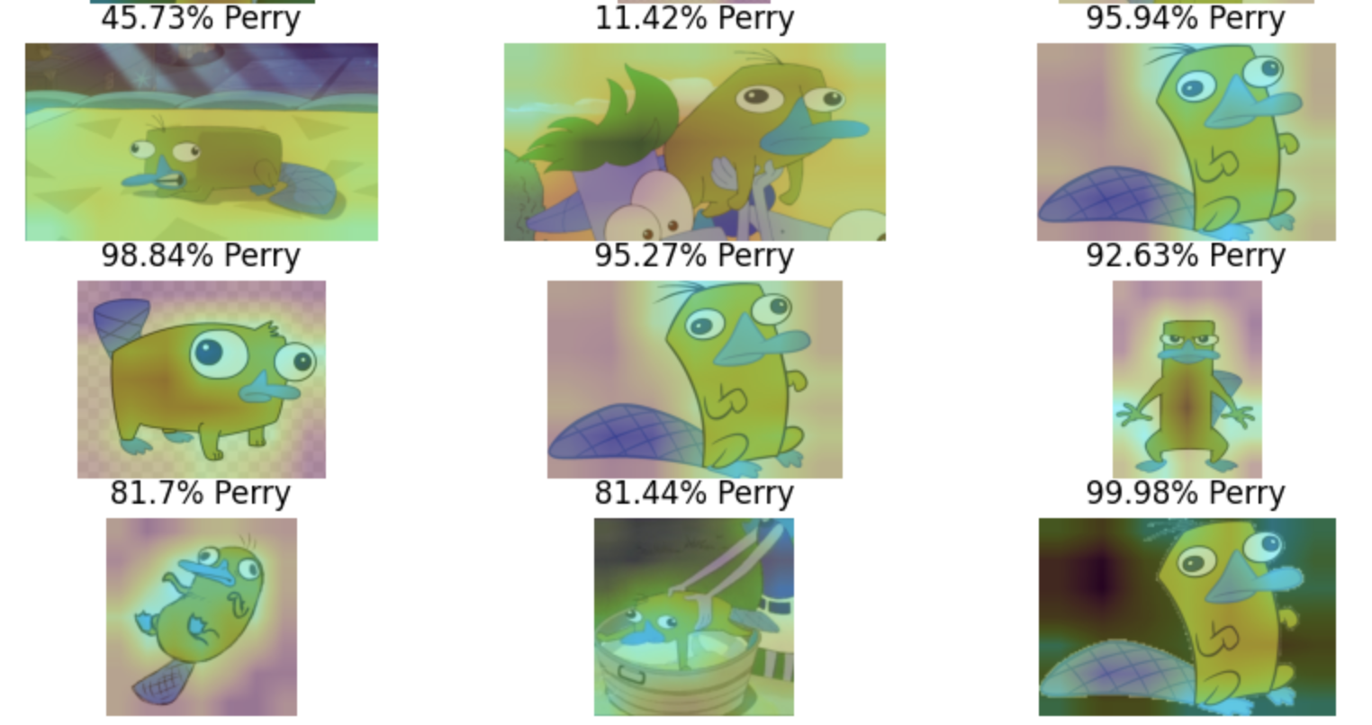
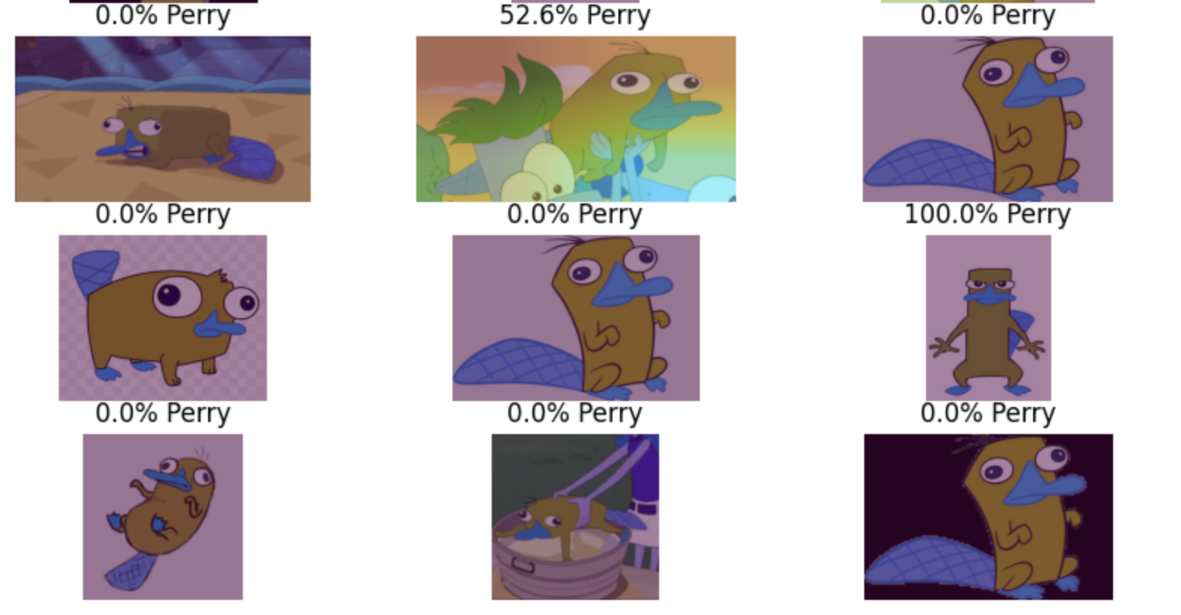
Model Results & Heatmap
Simple CNN
Transfer Learning Model
Accuracy not as good
Heatmap shows the shape of the platypus
Better accuracy
Unclear what the heatmap is picking up
Notes:
cnn about 52% (which is basically a random guess) - not differentiating the hat
transfer learning model 82% accuracy - cant tell what it is differentiating
We can see that the feature maps closer to the input of the model capture more details in the image and that as we progress deeper into the model, the feature maps show less and less detail.
This pattern was to be expected, as the model abstracts the features from the image into more general concepts that can be used to make a classification. Although it is not clear from the final image that the model saw a hat, we generally lose the ability to interpret these deeper feature maps

Slide 11
05
Conclusion

Slide 12
Conclusion
Having a pre-trained model improves the accuracy
As we progress deeper into the model, the feature maps show less and less detail so it is hard to interpret what it is detecting.

Slide 13
06
Fun fact

Slide 14
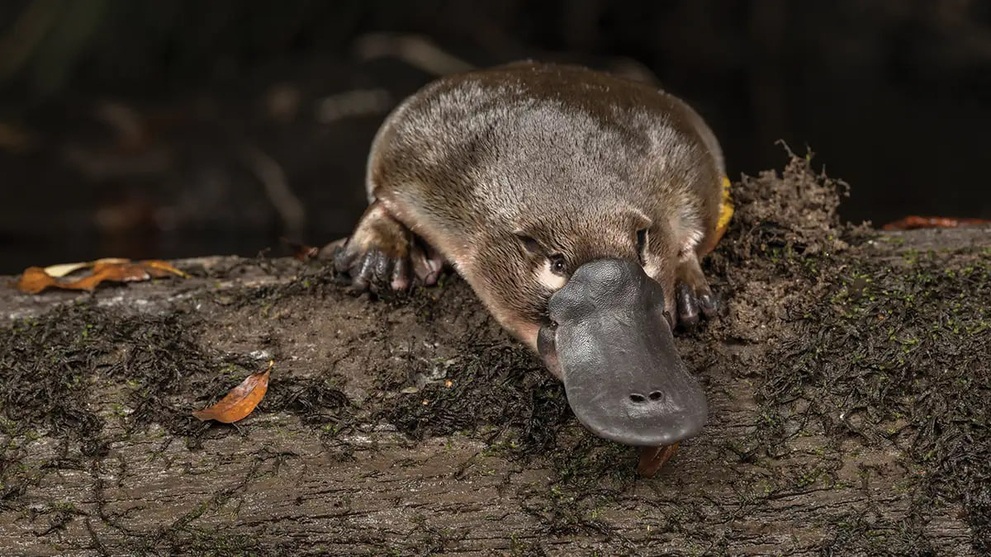
Male platypus are venomous

Slide 15
Resources
Kaggle dataset https://www.kaggle.com/datasets/riyaelizashaju/platypus-or-perry-the-platypus
Visualise Class Activation Maps https://pyimagesearch.com/2020/03/09/grad-cam-visualize-class-activation-maps-with-keras-tensorflow-and-deep-learning/
DS340 HW Assignment
Image classification https://keras.io/examples/vision/image_classification_from_scratch/
Slidesgo

